Slide 1

Collaborative Care & Health IT Innovations Summit: Interoperability in Post-Acute Care
June 24, 2019

Slide 2
Overview
Post-Acute Care Background
Post-Acute Care Landscape Analysis
Data Element Library
Fast Healthcare Interoperability Resources (FHIR) Development
FHIR Application Programming Interface (API) for the Data Element Library
PACIO Project

Slide 3
Why is Post-Acute Care Important?
Hospitalization
HHA (47.8%)
SNF (42.1%)
IRF (8.4%)
PAC (45%)
No PAC services (55%)
HHA Only (72.3%)
Acute (24.5%)
SNF (2.5%)
IRF (0.4%)
LTCH/ LTCH SN (0.2%)
LTCH/ LTCH SN (1.7%)
SNF Only (38.7%)
HHA (42.2%)
Acute (18.8%)
IRF (0.3%)
LTCH/ LTCH SN (0.1%)
Approximately 33,000 PAC Providers in the U.S. care for 6.9 million beneficiaries costing over $73.8 billion annually
After a hospitalization, 45% of patients required PAC services. HHA and SNFs were the most utilized services after a hospital admission
Of those patients that required HHA services after a hospital admission, 72.3% did not require any further services
Of those patients that required SNF services 38.7% did not require any further services but 42.2% transitioned to HHA.

Slide 4
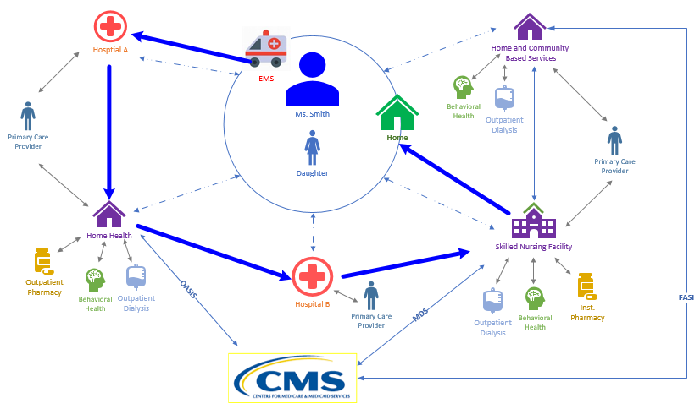
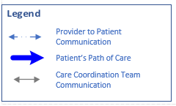
The Patient Story
Source: CMS DCPAC

Slide 5
Points of Failure
Poor communication across care providers, including outpatient
Medication discrepancies such as drug omissions during transitions of care are common
Multiple modes of information transmission are often used
Delays in PAC services can lead to adverse events and preventable readmissions
Redundant information collection creates inefficiencies and burden
Reliance on patient recall during periods of high stress
Recall of information can be unreliable
Patients may be unconscious, incapacitated, or otherwise unresponsive / unable to communicate information
Increased patient / family stress
Increased Cost and Provider Burden
Additional costs related to hospital stays from adverse events, readmissions
Additional administrative costs to locate, reconcile, and coordinate information
Longer length of stays and higher resource utilization

Slide 6
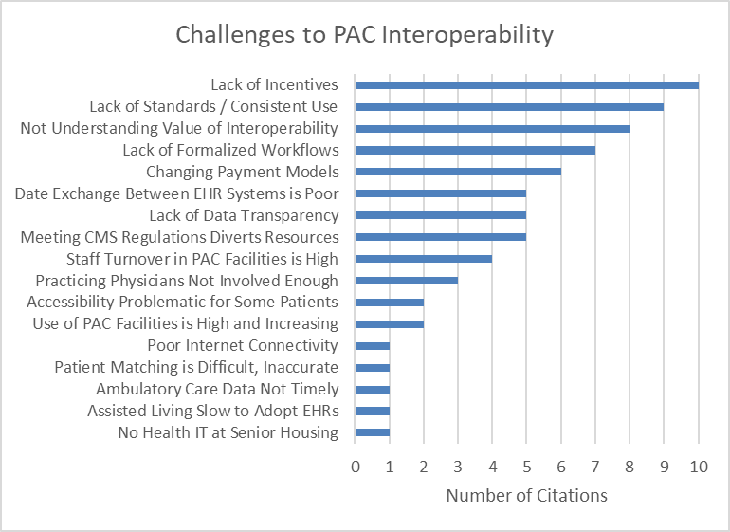
PAC Interoperability Challenges

Slide 7
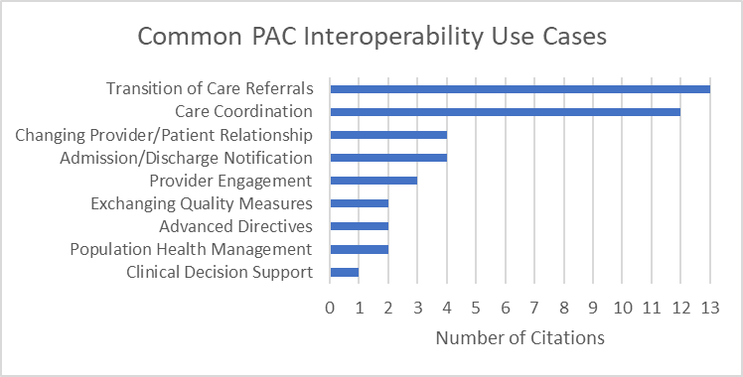
PAC Interoperability Use Cases

Slide 8



Big Picture: Strategic Focus Areas
Strategic Focus Areas
Empowering Patients: Patient Access
Ensure patients have access to and use of their own health information and are empowered to make better decisions about their care
Unleashing Innovation: Provider and Payer Health Information Exchange
Facilitate electronic information exchange of health information between providers and between payers
Focusing on Results: Data Driven Decision Making
Allow all players, including providers, researchers and payers to use available data to inform evidence-based decisions, modeling and research

Slide 9
IMPACT Act and the Data Element Library (DEL)
The IMPACT Act calls for standardization and interoperability of PAC assessment instrument DEs
Standardization and Interoperability of DEs supports:
Quality Measurement
Payment Transformation
Care Planning
Survey and Certification
Promotion of Health Information Exchange (HIE) to support:
Care coordination
Improved health care efficiency
Improved patient outcomes
Reduced costs
To promote interoperability in PAC, in June 2018 CMS developed and launched the Data Element Library (DEL), which is a centralized public resource for CMS PAC assessment instrument DEs (e.g. questions and response options), and their related mappings to nationally accepted health IT standards (including LOINC, SNOMED, C-CDA*, FHIR*)
DEL allows for access to and enables reuse and exchange of DEs
DEL maintains consistency in format, meaning, and use of Assessment Instrument Des
DEL does not contain any patient data
Visit the DEL here: https://del.cms.gov
* = Under Construction

Slide 10
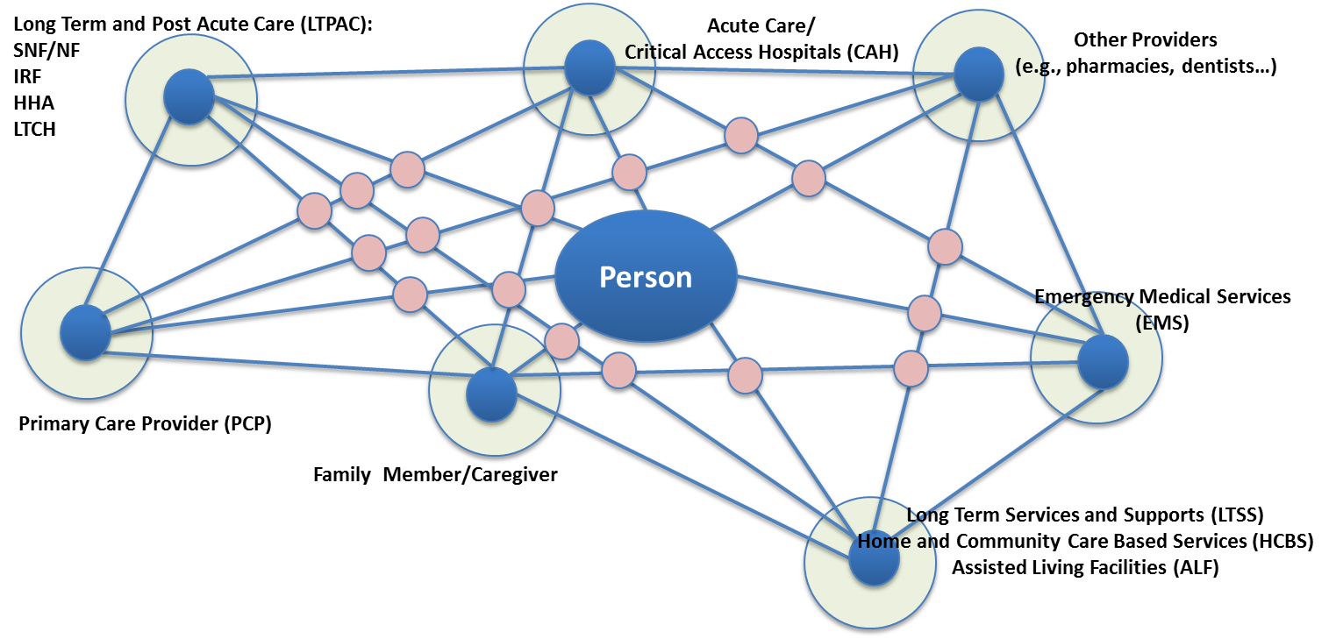
Guiding Principle: Data Needs to Follow the Person
Support data availability in real-time. Electronic information is exchanged and used by health IT systems without special effort on the part of the user.
Source: RTI International

Slide 11
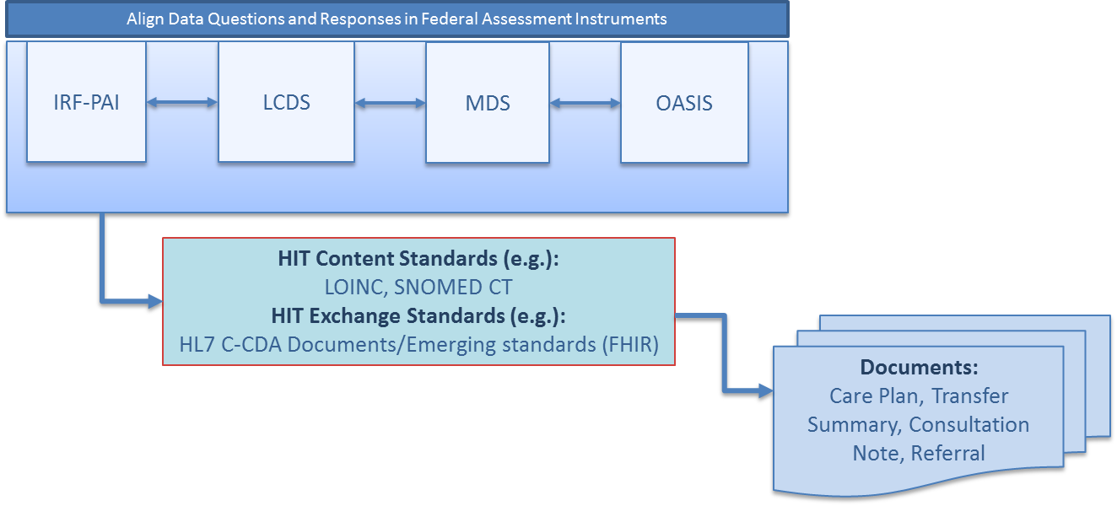
Making PAC Assessment Data Elements Standardized/Aligned and Interoperable
PAC Setting | CMS Assessment
Long-term Care Hospitals (LTCHs) | LTCH Continuity Assessment Record & Evaluation (CARE) Data Set (LCDS)
Skilled Nursing Facilities (SNFs) | Resident Assessment Instrument (RAI) Minimum Data Set (MDS)
Home Health Agencies (HHAs) | Outcome and Assessment Information Set (OASIS)
Inpatient Rehabilitation Facilities (IRFs) | IRF patient assessment instrument (IRF-PAI)
Hospices | Hospice Item Set
Relevant interoperable assessment data (such as functional status, cognitive status, etc.) can be used to populate documents
Source: RTI International

Slide 12
FHIR API for the Data Element Library: Potential Use Cases
Support apps for clinician or home health care to perform assessment
Query list of potential responses to an assessment
For example, populating a drop-down menu in a client app (e.g., EHR)
Add / update new assessments
Create new assessments including new assessment values
Update assessments or corresponding assessment values
Requires proper authentication and authorization
Change reflected immediately in client apps (e.g., EHR)

Slide 13
FHIR API for the Data Element Library: Current Status of Development
Done
Generated initial implementation guide
Setup instance of HAPI FHIR server and loaded DEL data into database
Loaded implementation guides into server
Mapped imported DEL data against StructureDefinitions in implementation guides
To Do
Finish implementation guide
Review implementation guide with:
HL7 Patient Care Working Group
HL7 Payer Working Group
HIT Working Group
PACIO Working Group
Complete reference implementation, automated tests, debug
Host reference implementation on HSPC so others can access resources
Integrate authentication and authorization (leveraging Blue Button work)

Slide 14

PACIO Project
The PACIO Project is a collaborative effort to advance interoperable health data exchange
between post-acute care providers, patients, and other key stakeholders.

Slide 15




PACIO Project Use Cases
Functional Status Use Case
Cognitive Status Use Case
Patient / Provider
Care Setting
Care Setting
Under Development:
FHIR Implementation Guide
Reference Implementation
Data Element Library
Assessments

Slide 16
Proposed Timeline for FHIR Work (Publish Dec 2019)
30 Jun, 2019
Jul 2019
NOTICE OF INTENT TO
BALLOT CONTENT
BALLOT
-
DEADLINE
Nov 2019
RECONCILIATION
28 Nov, 2018
Mar 2019
Sep 2019
Dec 2019
PROJECT SCOPE STATEMENT
2019 WGM AND
PUBLISH FHIR
TAG
CONNECTATHON
IMPLEMENTATION
IN ATLANTA
GUIDE
LANDSCAPE ANALYSIS
GENERATE FHIR PROFILES
1 October 2018
Nov 2018
Dec 2018
Jan 2019
Feb 2019
Mar 2019
Apr 2019
May 2019
Jun 2019
Jul 2019
Aug 2019
Sep 2019
Oct 2019
Nov 2019
Dec 2019
Jan 2020
Feb 2020
Mar 2020
31 March 2020
Oct 2019
NEW FISCAL YEAR

